Slide 1
Lattice Dynamics
By :- Shivansh Jaiswal(B20MT041)

Slide 2
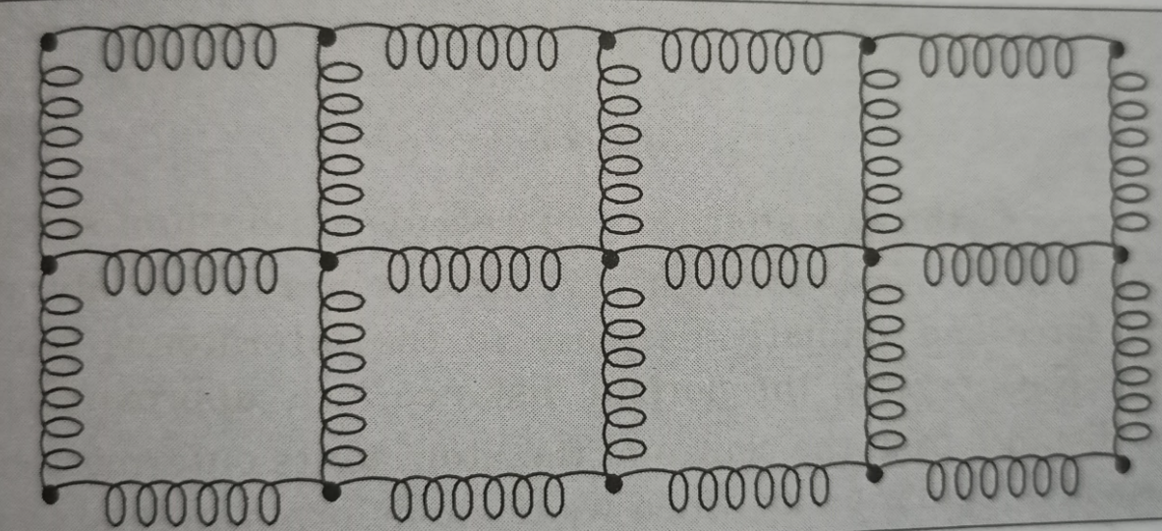
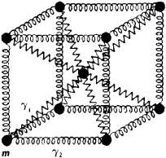
What is Lattice Dynamics
Lattice Dynamics is the Study of the vibration of the atom in a crystal lattice.

Slide 3
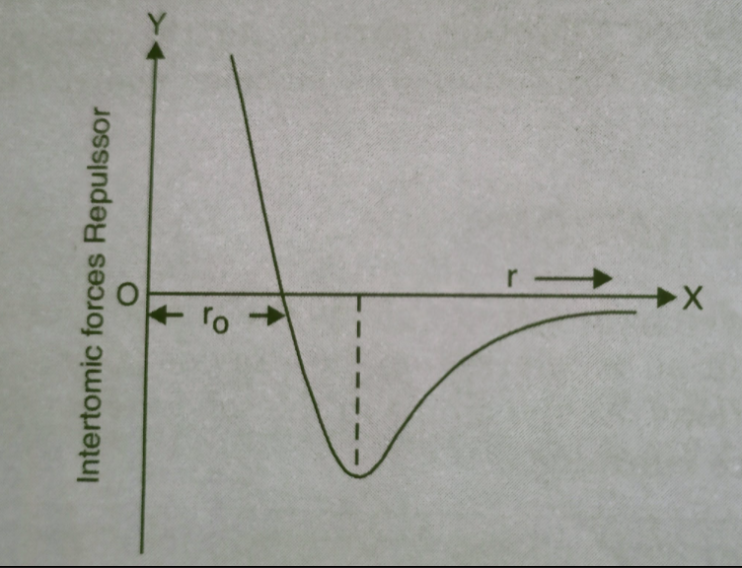
Lattice Vibratiations
Every atom has a tendency to vibrate about their mean position at temperature above zero Kelvin.
The mean position is referred as the Bravais lattice site. These vibrations occur due to interatomic interactions.
As the atoms in the solids are present at lattice sites , so these vibrations are called lattice vibrations.

Slide 4
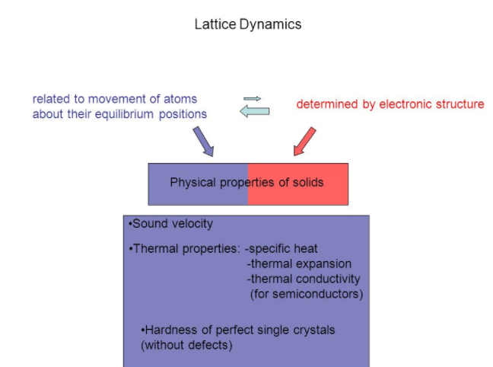

Slide 5
Phonons
A phonon is the quantum mechanical description of an elementary vibrational motion in which a lattice of atoms or molecules uniformly oscillates at a single frequency. In classical mechanics this designates a normal mode of vibration.

Slide 6
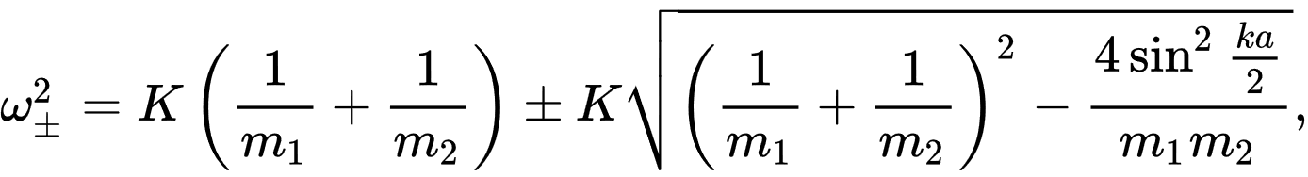
Phonons Dispersion Relation
For a one-dimensional alternating array of two types of ion or atom of mass m₁, m₂ repeated periodically at a distance a, connected by springs of spring constant K, two modes of vibration
result:
The connection between frequency and wavevector, ω = ω(k), is known as a dispersion relation. The plus sign results in the so-called optical mode, and the minus sign to the acoustic mode.

Slide 7
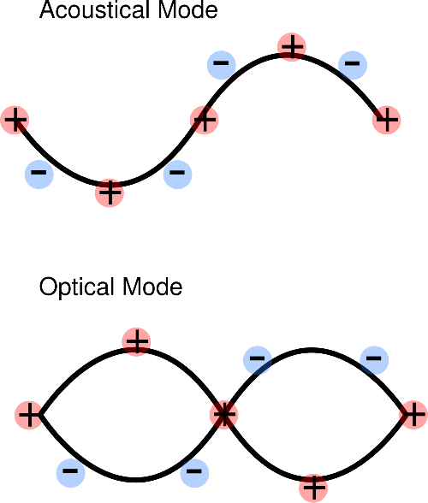
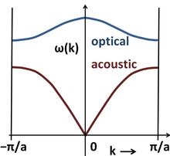

Slide 8
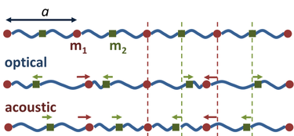
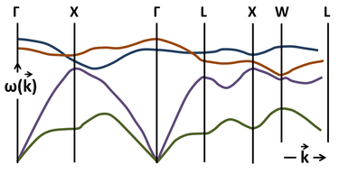

Slide 9
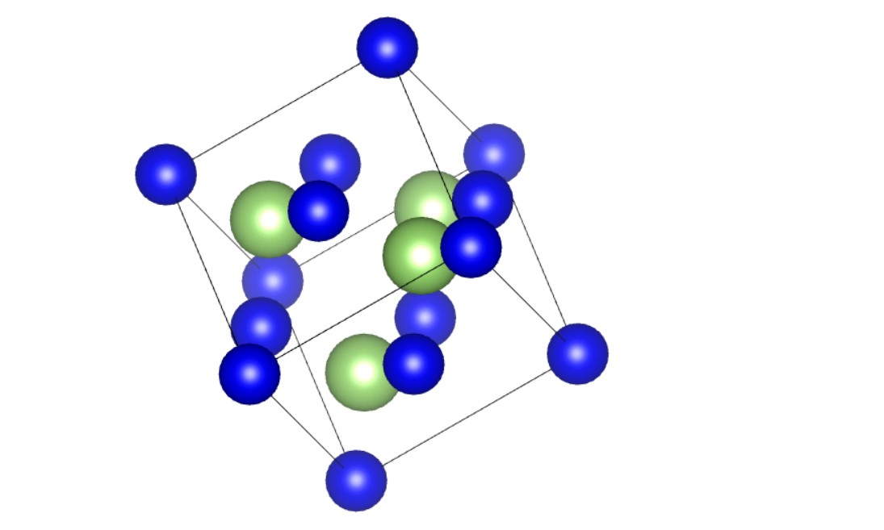

Slide 10
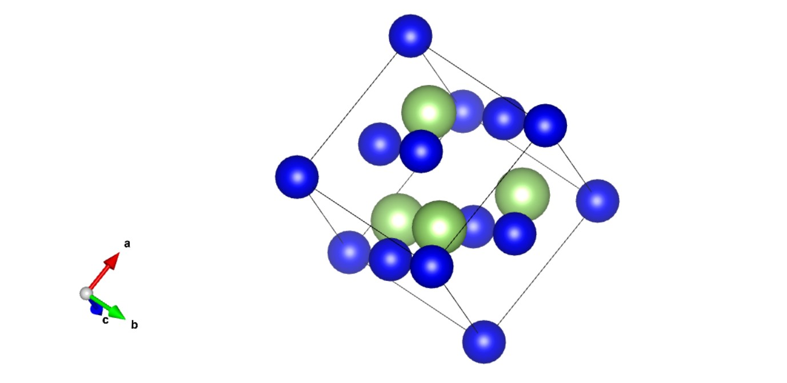

Slide 11
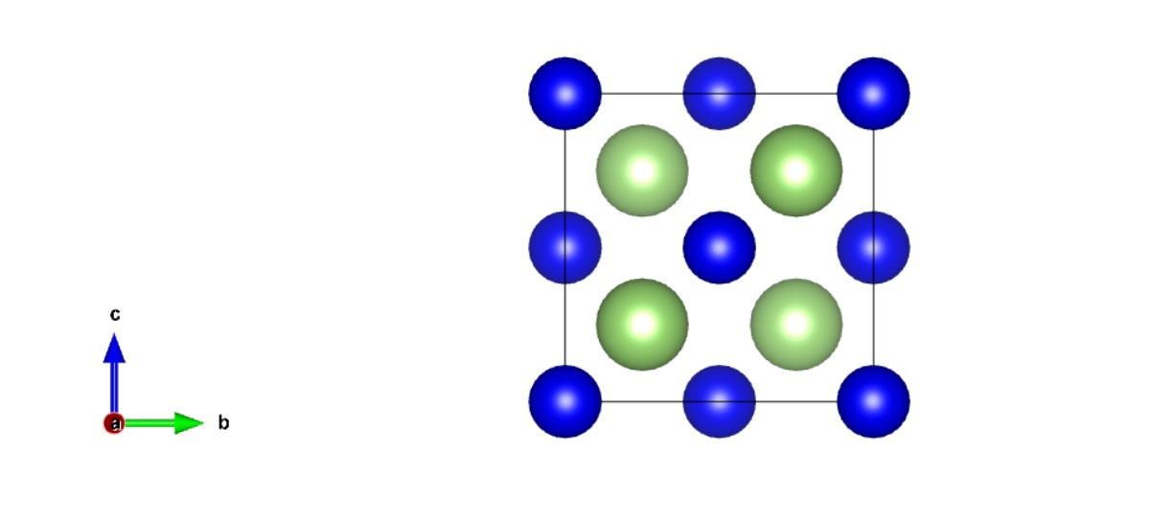

Slide 13
Thank You

